Slide 1

ALL DAY DATA
CHETAN NIGUDGI
DOLLAR VORA
MANALI CHHEDA
THEJAS SAMPATHKUMAR

Slide 2
OVERVIEW:

Slide 3
Work Distribution:

Slide 4
Assumptions
Data provided by the 3rd party is independent of the manufacturing system, the integrated data can help in forecasting the car sales and in-turn fine tune the inventory.
Analysis of the system is done taking Tire type(Brand) and Car color attributes into account.
The sales order and inventory is updated monthly.

Slide 5
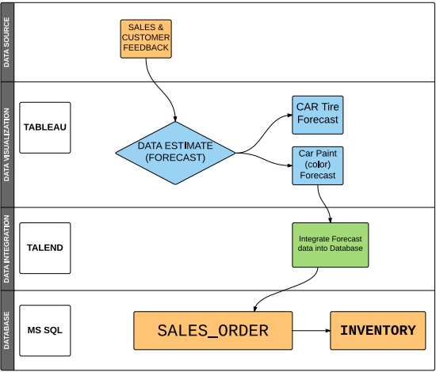



Architecture

Slide 6
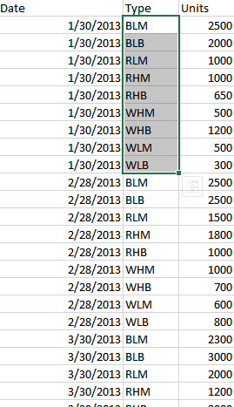
Data Source
3rd Party provides the integrated sales data as well as
the customer feedback data.
Eg: Ford Data Crunchers
Supplier Data from the Car raw materials Dealars in Boston Area.

Slide 7
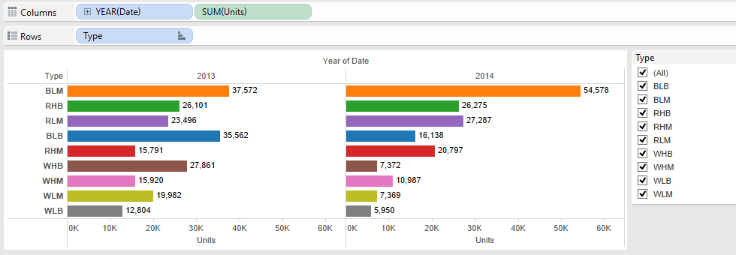
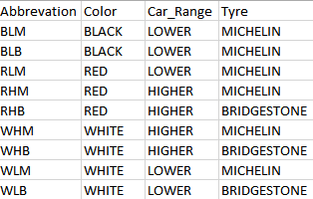
Data Source(Conti…)

Slide 8
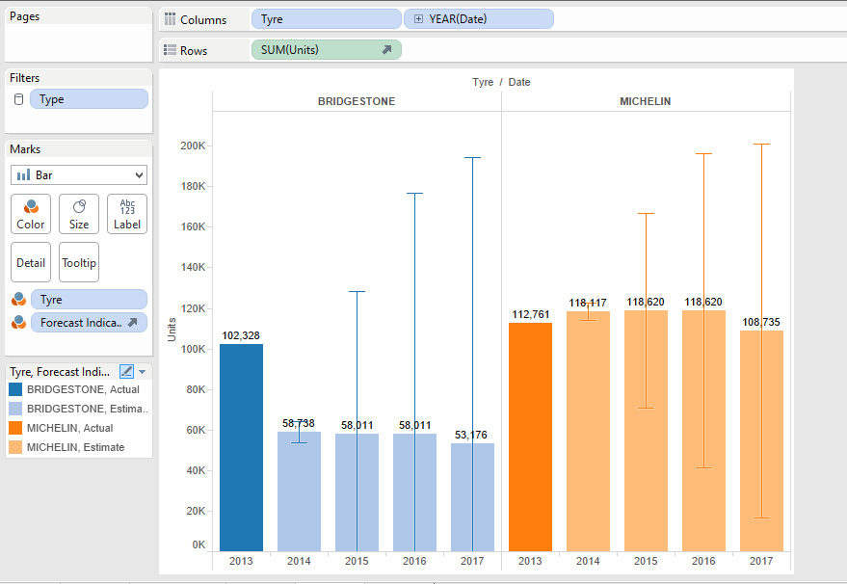
Forecasting VISUALIZATIONS- TABLEAU

Slide 9
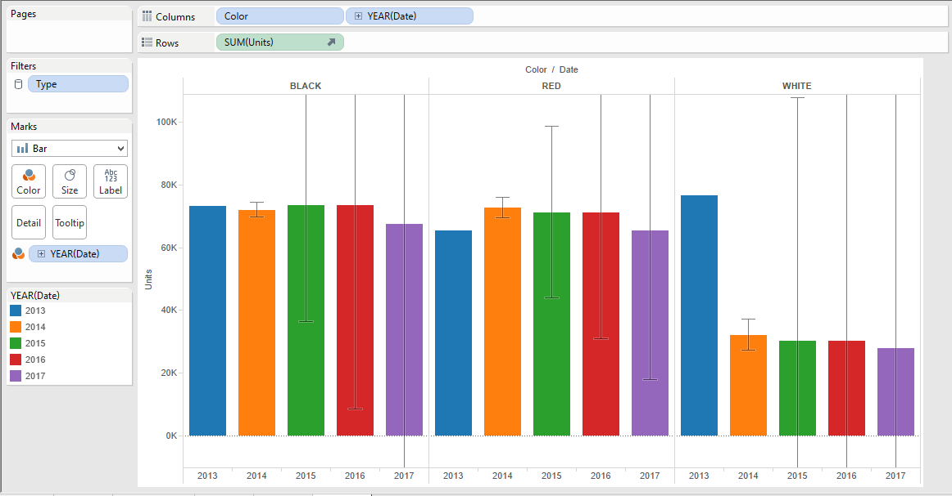
Visualization(Conti…)

Slide 10
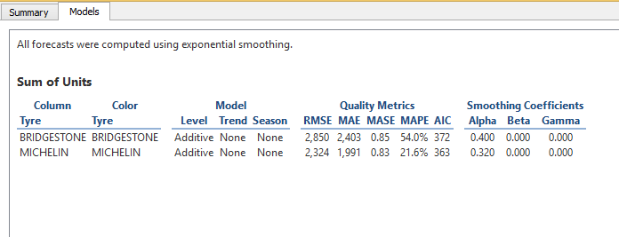
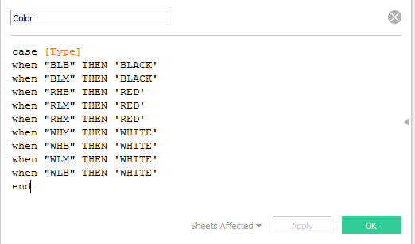
Forecasting Derivations and Model

Slide 11
Data Integration
Used Talend Open Studio for Integration.
Metadata connections for SQL server and CSV files.
Output:
1. Table for Car color forecast.
The table has the estimate data and count of the different colored cars sold for the year 2015 and 2016.
2. Table for Car tyre type forecast.
The table has all the data identifying all the type of tires used in the cars and estimate of the each of the type of tires used for manufacturing for the year 2015 and 2016.

Slide 12
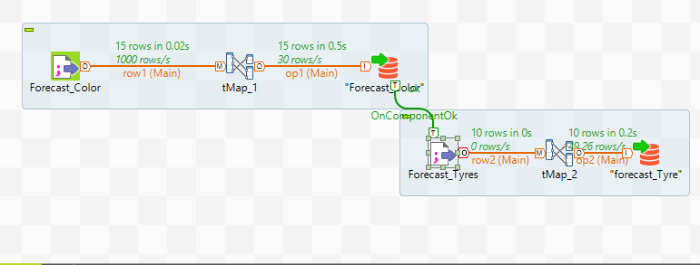
DATA Integration

Slide 13
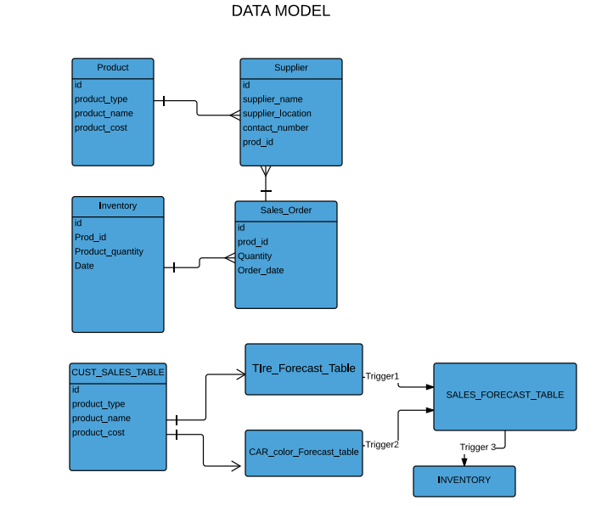
Data Model

Slide 14
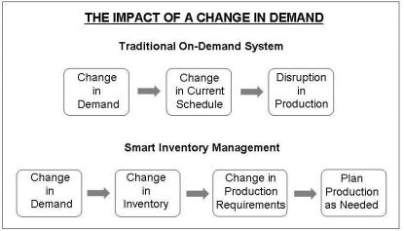
Smart Inventory Impact

Slide 15
References:
http://www.goodcarbadcar.net/2011/01/honda-cr-v-sales-figures.html
http://boston.cityvoter.com/best/tire-shop/auto/boston
http://promoldplastics.com/PDFs/Smart-Inventory-Management.pdf
http://www.tableau.com/learn/tutorials/on-demand/forecasting

